Slide 1
Numbering Systems
Alamu Femi O PhD

Slide 2
We have discussed how computers remember numbers using transistors, tiny devices that act like switches with only two positions, on or off.
A single transistor, therefore, can only remember one of two possible numbers, a “one” or a “zero”.
This isn't useful for anything more complex than controlling a light bulb, so for larger values, transistors are grouped together so that their combination of ones and zeros can be used to represent larger numbers.
It is therefore important to discusses some of the methods that are used to represent numbers with groups of transistors or bits.

Slide 3
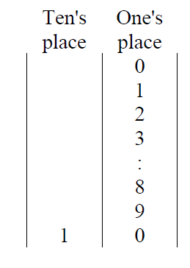
Unsigned Binary Counting
The simplest form of numeric representation with bits is unsigned binary.
When we count upward through the positive integers using decimal, we start with a “0” in the one's place and increment that value until we reach the upper limit of a single digit, i.e., 9.
At that point, we've run out of the "symbols" we use to count, and we need to increment the next digit, the ten's place.
We then reset the one's place to zero, and start the cycle again.
Since computers do not have an infinite number of transistors, the number of digits that can be used to represent a number is limited.
Counting in Decimal

Slide 4
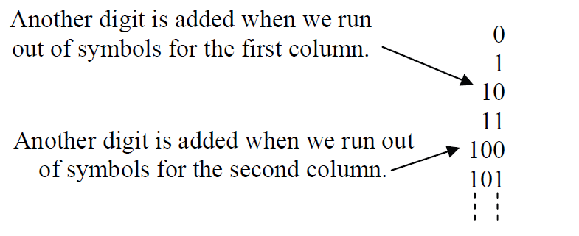
The Figure below shows that when counting in binary, we run out of symbols quickly requiring the addition of another "place“ after only the second increment.
Counting in Binary

Slide 5
If we were counting using four bits, then the sequence would look like:
    0000, 0001, 0010, 0011, 0100, 0101, 0110, 0111, 1000, 1001,
    1010, 1011, 1100, 1101, 1110, and 1111.
Notice that when restricted to four bits, we reach our limit at 1111, which happens to be the fifteenth value.
It should also be noted that we ended up with 2 x 2 x 2 x 2 = 16 different values.
With two symbols for each bit, we have 2^{n} possible combinations of symbols where n represents the number of bits.

Slide 6
In binary, the rightmost place is considered the ones place just like decimal.
The next place is incremented after the ones place reaches 1. This means that the second place in binary represents the value after 1, i.e., a decimal 2.
The third place is incremented after a 1 is in both the ones place and the twos place, i.e., we've counted to a decimal 3.
Therefore, the third place represents a decimal 4.
Continuing this process shows us that each place in binary represents a successive power of two.

Slide 7
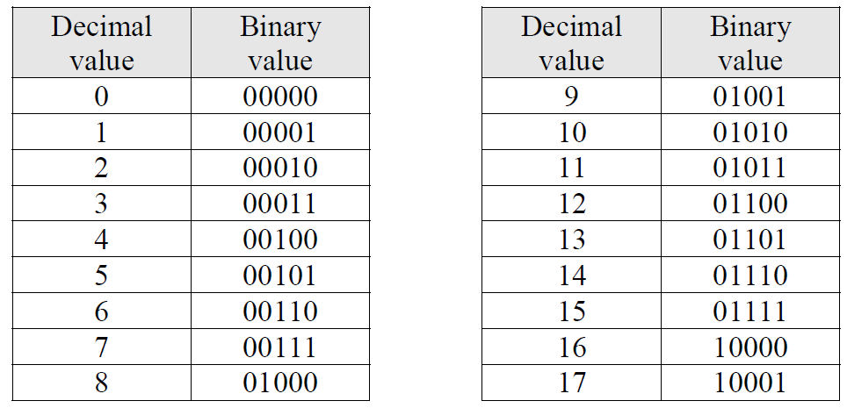
The Figure below uses 5 bits to count up to a decimal 17. Examine each row where a single one is present in the binary number. This reveals what that position represents.
For example, a binary 01000 is shown to be equivalent to a decimal 8. Therefore, the fourth bit position from the right is the 8’s position.
Binary-Decimal Equivalents from 0 to 17

Slide 8
The information above helps us develop a method for converting unsigned binary numbers to decimal and back to unsigned binary.
This gives us a method for indicating which representation is being used when writing a number down on paper.
    For example, does the number 100 represent a decimal value or a binary value?
Since binary is base-2 and decimal is base-10, a subscript "2" is placed at the end of all binary numbers and a subscript "10" is placed at the end of all decimal numbers.
This means a binary 100 should be written as 100₂ and a decimal 100 should be written as 100₁₀.

Slide 9
Binary Terminology
When writing values in decimal, it is common to separate the places or positions of large numbers in groups of three digits separated by commas.
For example, 345323745₁₀ is typically written 345,323,745₁₀ showing that there are 345 millions, 323 thousands, and 745 ones.
This practice makes it easier to read and comprehend the magnitude of the numbers.
Binary numbers are also divided into components depending on their application. Each binary grouping has been given a name.

Slide 10
To begin with, a single place or position in a binary number is called a bit, short for binary digit. For example, the binary number 0110₂ is made up of four bits.
The rightmost bit, the one that represents the ones place, is called the Least Significant Bit or LSB.
The leftmost bit, the one that represents the highest power of two for that number, is called the Most Significant Bit or MSB.
Note that the MSB represents a bit position. It doesn't mean that a '1' must exist in that position.

Slide 11
The next four terms describe how bits might be grouped together.
    • Nibble – A four bit binary number
    • Byte – A unit of storage for a single character, typically an eight bit (2 nibble) binary number (short for binary term)
    • Word – Typically a sixteen bit (2 byte) binary number
    • Double Word – A thirty-two bit (2 word) binary number
The following are some examples of each type of binary number.
  Bit 1₂
  Nibble 1010₂
  Byte 10100101₂
  Word 1010010111110000₂
  Double Word 10100101111100001100111011101101₂

Slide 12
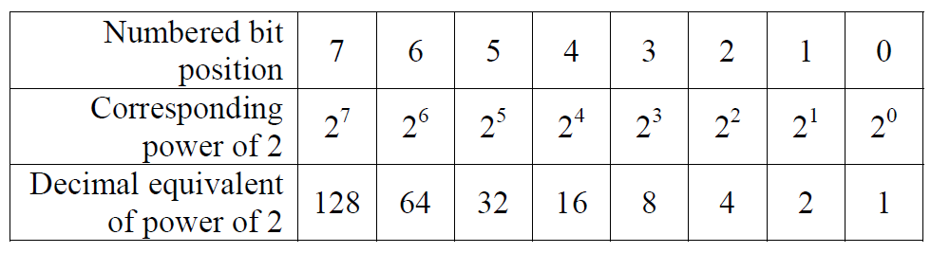
Unsigned Binary to Decimal Conversion
Each place or position in a binary number corresponds to a specific power of 2 starting with the rightmost bit which represents 2⁰=1.
It is through this organization of the bits that we will convert binary numbers to their decimal equivalent.
The Figure below shows the bit positions and the corresponding powers of two for each bit in positions 0 through 7.
Values Represented By Each of the First 8 Bit Positions

Slide 13
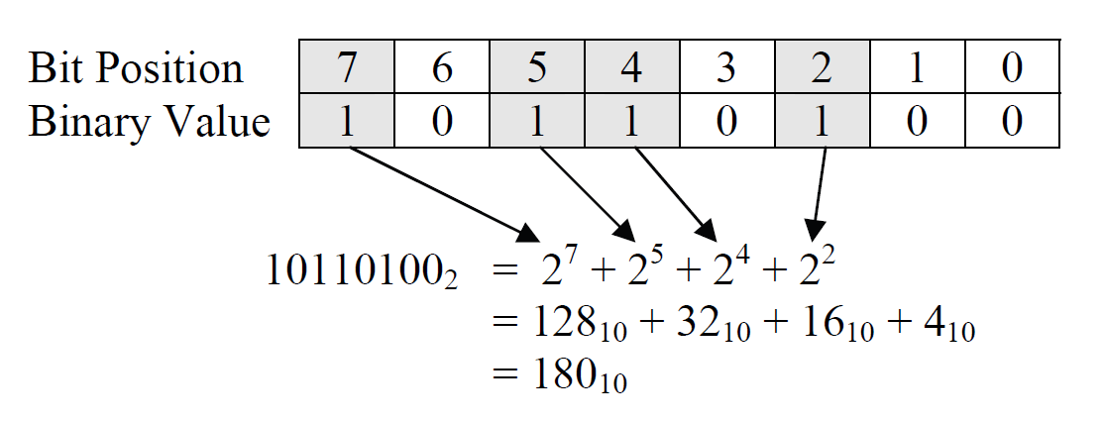
To begin converting an unsigned binary number to decimal, identify each bit position that contains a 1.
It is important to note that we number the bit positions starting with 0 identifying the rightmost bit.
Next, add the powers of 2 for each position containing a 1. This sum is the decimal equivalent of the binary value.
Sample Conversion of 101101002 to Decimal

Slide 14
This brings up an important issue when representing numbers with a computer. Note that when a computer stores a number, it uses a limited number of transistors.
If, for example, we are limited to eight transistors, each transistor storing a single bit, then we have an upper limit to the size of the decimal value we can store.
The largest unsigned eight bit number we can store has a 1 in all eight positions, i.e., 11111111₂. This number cannot be incremented without forcing an overflow to the next highest bit.
Therefore, the largest decimal value that 8 bits can represent in unsigned binary is the sum of all powers of two from 0 to 7.
    11111111₂ = 2⁷ + 2⁶ + 2⁵ + 2⁴ + 2³ + 2² + 2¹ + 2⁰
    = 128 + 64 + 32 + 16 + 8 + 4 + 2 + 1
    = 255₁₀

Slide 15
If you add one to this value, the result is 256 which is 2⁸, the power of two for the next bit position. This makes sense because if you add 1 to 11111111₂, then beginning with the first column, 1 is added to 1 giving us a result of 0 with a 1 carry to the next column.
This propagates to the MSB where a final carry is passed to the ninth bit.
The final value is then 100000000₂ = 256₁₀.
11111111₂ + 1 = 100000000₂ = 256₁₀ = 2⁸
Therefore, the maximum value that can be represented with 8 bits in unsigned binary is 2⁸ – 1 = 255.
It turns out that the same result is found for any number of bits. The maximum value that can be represented with n bits in unsigned binary is 2^{n} – 1.

Slide 16
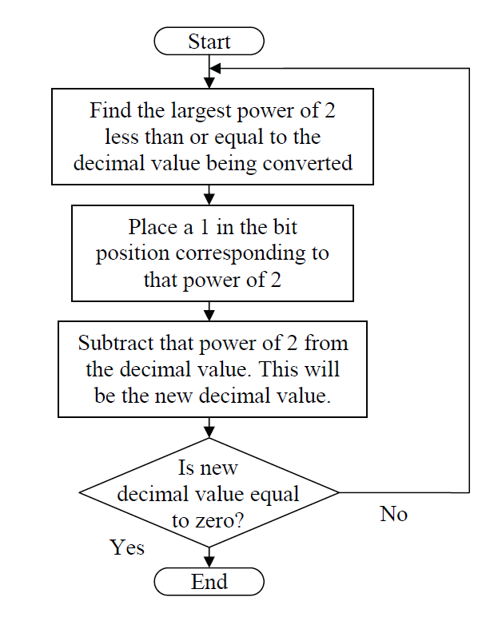

Slide 17
Binary Numbers
Hexadecimal Numbers
Base Conversions
Integer Storage Sizes
Binary and Hexadecimal Addition
Signed Integers and 2's Complement Notation
Binary and Hexadecimal subtraction
Carry and Overflow
Character Storage

Slide 18
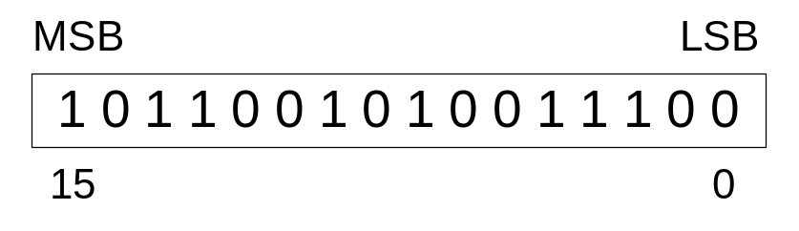
Binary Numbers
Digits are 1 and 0
  1 = true
  0 = false
MSB – most significant bit
LSB – least significant bit
Bit numbering:

Slide 19
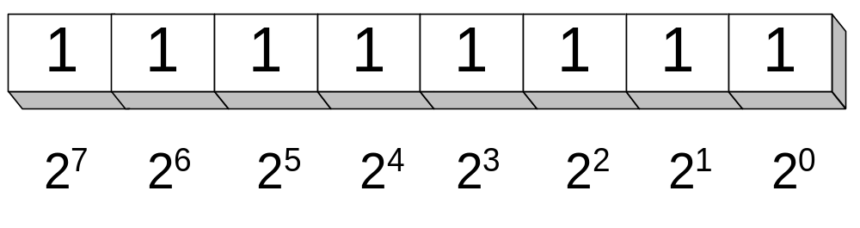
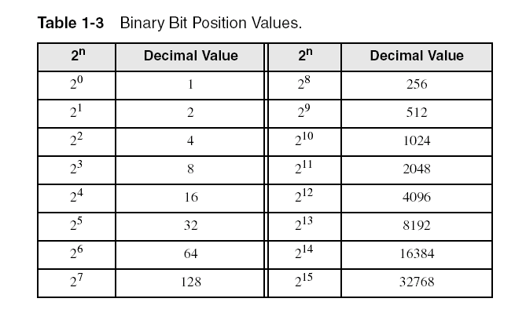
Binary Numbers
Each digit (bit) is either 1 or 0
Each bit represents a power of 2:
Every binary number is a sum of powers of 2

Slide 20
Converting Binary to Decimal
Weighted positional notation shows how to calculate the decimal value of each binary bit:
Decimal = (d_{n-1} × 2^{n-1}) + (d_{n-2} × 2^{n-2}) + ... + (d₁ × 2¹) + (d₀ × 2⁰)
d = binary digit
binary 00001001 = decimal 9:
(1 × 2³) + (1 × 2⁰) = 9

Slide 21
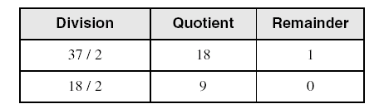
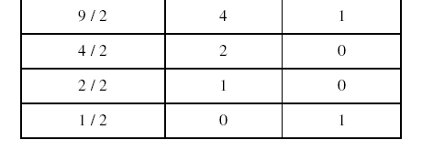
Convert Unsigned Decimal to Binary
Repeatedly divide the decimal integer by 2. Each remainder is a binary digit in the translated value:
least significant bit
most significant bit
stop when quotient is zero
37 = 100101

Slide 22
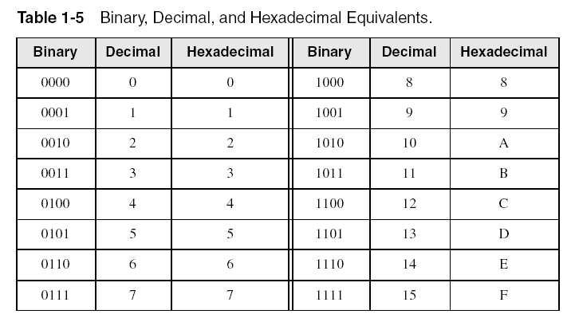
Hexadecimal Integers
Binary values are represented in hexadecimal.

Slide 23

Converting Binary to Hexadecimal
Each hexadecimal digit corresponds to 4 binary bits.
Example: Translate the binary integer 000101101010011110010100 to hexadecimal:

Slide 24
Converting Hexadecimal to Decimal
Multiply each digit by its corresponding power of 16:
Decimal = (d₃ × 16³) + (d₂ × 16²) + (d₁ × 16¹) + (d₀ × 16⁰)
d = hexadecimal digit
Examples:
  Hex 1234 = (1 × 16³) + (2 × 16²) + (3 × 16¹) + (4 × 16⁰) =
  Decimal 4,660
  Hex 3BA4 = (3 × 16³) + (11 * 16²) + (10 × 16¹) + (4 × 16⁰) =
  Decimal 15,268

Slide 25
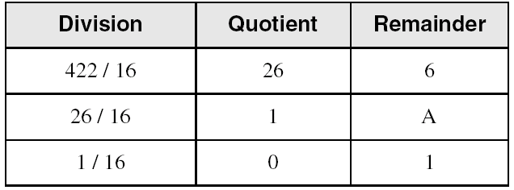
Converting Decimal to Hexadecimal
Repeatedly divide the decimal integer by 16. Each remainder is a hex digit in the translated value:
least significant digit
most significant digit
stop when quotient is zero
Decimal 422 = 1A6 hexadecimal

Slide 26
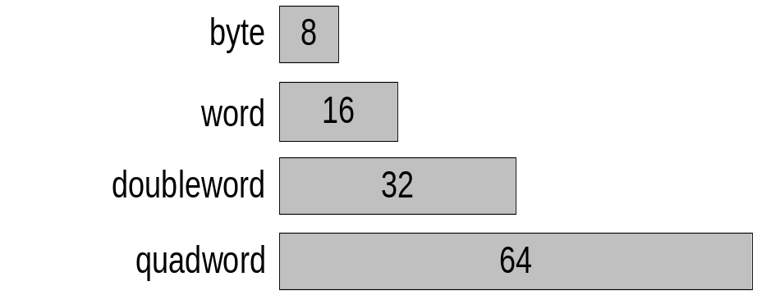
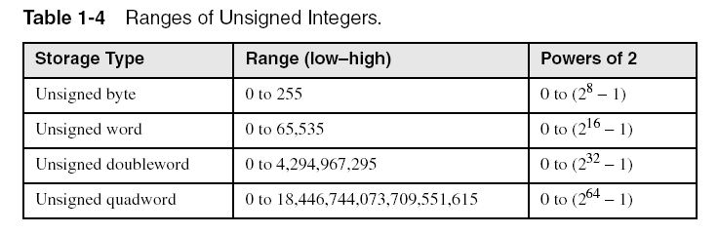
Integer Storage Sizes
Standard sizes:
Class work
What is the largest unsigned integer that may be stored in 20 bits?

Slide 27
Binary Math and Signed Representations
Alamu Femi O. PhD

Slide 28
Binary Addition
Start with the least significant bit (rightmost bit)
Add each pair of bits
Include the carry in the addition, if present
carry:
1
0
0
0
0
0
1
0
0
(4)
+
0
0
0
0
0
1
1
1
(7)
0
0
0
0
1
0
1
1
(11)
bit position:
7
6
5
4
3
2
1
0

Slide 29
Hexadecimal Addition
Divide the sum of two digits by the number base (16). The quotient becomes the carry value, and the remainder is the sum digit.
1
1
36 28 28 6A
42 45 58 4B
78 6D 80 B5
21 / 16 = 1, remainder 5
Important skill: Programmers frequently add and subtract the addresses of variables and instructions.

Slide 30
Signed Integers
Several ways to represent a signed number
  Sign-Magnitude
  Biased
  1's complement
  2's complement
Divide the range of values into 2 equal parts
  First part corresponds to the positive numbers (≥ 0)
  Second part correspond to the negative numbers (< 0)
Focus will be on the 2's complement representation
  Has many advantages over other representations
  Used widely in processors to represent signed integers

Slide 31
Two's Complement Representation
Positive numbers
  Signed value = Unsigned value
Negative numbers
  Signed value = Unsigned value – 2^{n}
  n = number of bits
Negative weight for MSB
  Another way to obtain the signed value is to assign a negative weight to most-significant bit
  = -128 + 32 + 16 + 4 = -76
8-bit Binary value | Unsigned value | Signed value
00000000 | 0 | 0
00000001 | 1 | +1
00000010 | 2 | +2
. . . | . . . | . . .
01111110 | 126 | +126
01111111 | 127 | +127
10000000 | 128 | -128
10000001 | 129 | -127
. . . | . . . | . . .
11111110 | 254 | -2
11111111 | 255 | -1
1
0
1
1
0
1
0
0
-128
64
32
16
8
4
2
1

Slide 32
Forming the Two's Complement
starting value | 00100100 = +36
step1: reverse the bits (1's complement) | 11011011
step 2: add 1 to the value from step 1 | + 1
sum = 2's complement representation | 11011100 = -36
Sum of an integer and its 2's complement must be zero:
00100100 + 11011100 = 00000000 (8-bit sum) ⇒ Ignore Carry
The easiest way to obtain the 2's complement of a binary number is by starting at the LSB, leaving all the 0's unchanged, look for the first occurrence of a 1. Leave this 1 unchanged and complement all the bits after it.

Slide 33
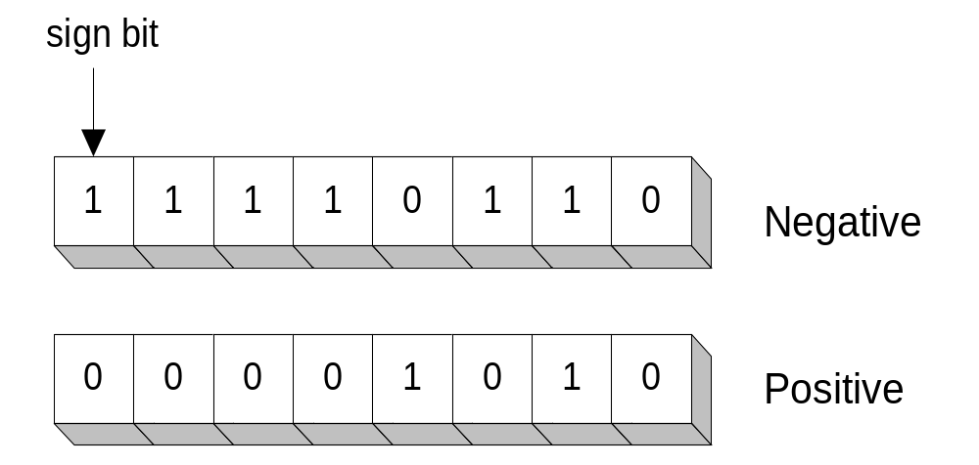
Sign Bit
Highest bit indicates the sign. 1 = negative, 0 = positive
If highest digit of a hexadecimal is > 7, the value is negative
Examples: 8A and C5 are negative bytes
A21F and 9D03 are negative words
B1C42A00 is a negative double-word

Slide 34
Sign Extension
Step 1: Move the number into the lower-significant bits
Step 2: Fill all the remaining higher bits with the sign bit
This will ensure that both magnitude and sign are correct
Examples
  Sign-Extend 10110011 to 16 bits
  Sign-Extend 01100010 to 16 bits
Infinite 0's can be added to the left of a positive number
Infinite 1's can be added to the left of a negative number
10110011 = -77
11111111 10110011 = -77
01100010 = +98
00000000 01100010 = +98

Slide 35
Two's Complement of a Hexadecimal
To form the two's complement of a hexadecimal
  Subtract each hexadecimal digit from 15
  Add 1
Examples: 15 15 15 15
  2's complement of 6 A 3 D = 95C2 + 1 = 95C3
  2's complement of 92F0 = 6D0F + 1 = 6D10
  2's complement of FFFF = 0000 + 1 = 0001
No need to convert hexadecimal to binary

Slide 36
Binary Subtraction
When subtracting A – B, convert B to its 2's complement
Add A to (–B)
0 0 0 0 1 1 0 0 0 0 0 0 1 1 0 0
0 0 0 0 0 0 1 0 1 1 1 1 1 1 1 0 (2's complement)
0 0 0 0 1 0 1 0 0 0 0 0 1 0 1 0 (same result)
Carry is ignored, because
  Negative number is sign-extended with 1's
  You can imagine infinite 1's to the left of a negative number
  Adding the carry to the extended 1's produces extended zeros
–
+
Practice: Subtract 00100101 from 01101001.

Slide 37
Hexadecimal Subtraction
When a borrow is required from the digit to the left, add 16 (decimal) to the current digit's value
Last Carry is ignored
16 + 5 = 21
-1
1
1
C675
A247
242E
C675
5DB9 (2's complement)
242E (same result)
-
+
Practice: The address of var1 is 00400B20. The address of the next variable after var1 is 0040A06C. How many bytes are used by var1?

Slide 38
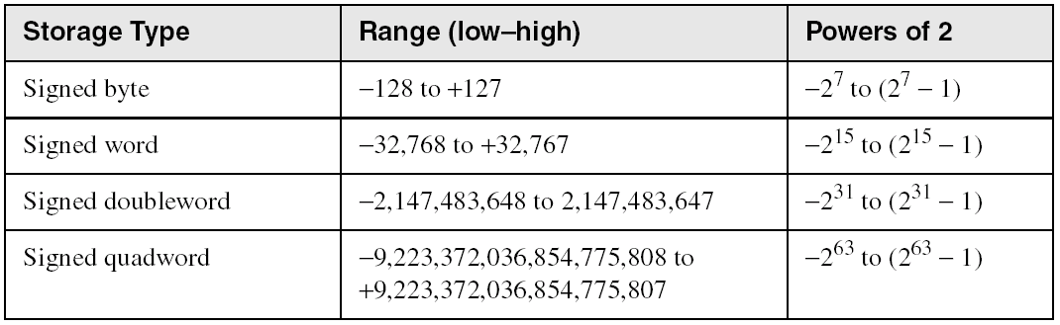
Ranges of Signed Integers
The unsigned range is divided into two signed ranges for positive and negative numbers
Practice: What is the range of signed values that may be stored in 20 bits?

Slide 39
Carry and Overflow
Carry is important when …
  Adding or subtracting unsigned integers
  Indicates that the unsigned sum is out of range
  Either < 0 or >maximum unsigned n-bit value
Overflow is important when …
  Adding or subtracting signed integers
  Indicates that the signed sum is out of range
Overflow occurs when
  Adding two positive numbers and the sum is negative
  Adding two negative numbers and the sum is positive
  Can happen because of the fixed number of sum bits

Slide 40
Carry and Overflow Examples
We can have carry without overflow and vice-versa
Four cases are possible
1
1
1
1
1
1
0
0
0
0
1
1
1
1
15
0
0
0
0
1
1
1
1
15
+
+
0
0
0
0
1
0
0
0
8
1
1
1
1
1
0
0
0
245 (-8)
0
0
0
1
0
1
1
1
23
0
0
0
0
0
1
1
1
7
Carry = 0 Overflow = 0
Carry = 1 Overflow = 0
1
1
1
1
0
1
0
0
1
1
1
1
79
1
1
0
1
1
0
1
0
218 (-38)
+
+
0
1
0
0
0
0
0
0
64
1
0
0
1
1
1
0
1
157 (-99)
1
0
0
0
1
1
1
1
143
(-113)
0
1
1
1
0
1
1
1
119
Carry = 0 Overflow = 1
Carry = 1 Overflow = 1

Slide 41
Character Storage
Character sets
  Standard ASCII: 7-bit character codes (0 – 127)
  Extended ASCII: 8-bit character codes (0 – 255)
  Unicode: 16-bit character codes (0 – 65,535)
  Unicode standard represents a universal character set
    Defines codes for characters used in all major languages
    Used in Windows-XP: each character is encoded as 16 bits
  UTF-8: variable-length encoding used in HTML
    Encodes all Unicode characters
    Uses 1 byte for ASCII, but multiple bytes for other characters
Null-terminated String
  Array of characters followed by a NULL character

Slide 42
Printable ASCII Codes
 | 0 | 1 | 2 | 3 | 4 | 5 | 6 | 7 | 8 | 9 | A | B | C | D | E | F
2 | space | ! | " | # | $ | % | & | ' | ( | ) | * | + | , | - | . | /
3 | 0 | 1 | 2 | 3 | 4 | 5 | 6 | 7 | 8 | 9 | : | ; | < | = | > | ?
4 | @ | A | B | C | D | E | F | G | H | I | J | K | L | M | N | O
5 | P | Q | R | S | T | U | V | W | X | Y | Z | [ | \ | ] | ^ | _
6 | ` | a | b | c | d | e | f | g | h | i | j | k | l | m | n | o
7 | p | q | r | s | t | u | v | w | x | y | z | { | | | } | ~ | DEL
Examples:
  ASCII code for space character = 20 (hex) = 32 (decimal)
  ASCII code for 'L' = 4C (hex) = 76 (decimal)
  ASCII code for 'a' = 61 (hex) = 97 (decimal)

Slide 43
Control Characters
The first 32 characters of ASCII table are used for control
Control character codes = 00 to 1F (hex)
  Not shown in previous slide
Examples of Control Characters
  Character 0 is the NULL character ⇒ used to terminate a string
  Character 9 is the Horizontal Tab (HT) character
  Character 0A (hex) = 10 (decimal) is the Line Feed (LF)
  Character 0D (hex) = 13 (decimal) is the Carriage Return (CR)
  The LF and CR characters are used together
    They advance the cursor to the beginning of next line
One control character appears at end of ASCII table
  Character 7F (hex) is the Delete (DEL) character

Slide 44
Terminology for Data Representation
Binary Integer
  Integer stored in memory in its binary format
  Ready to be used in binary calculations
ASCII Digit String
  A string of ASCII digits, such as "123"
ASCII binary
  String of binary digits: "01010101"
ASCII decimal
  String of decimal digits: "6517"
ASCII hexadecimal
  String of hexadecimal digits: "9C7B"

Slide 45
Gray Codes
The use of binary counting sequences is common in digital applications. For example, an n-bit binary value can be used to identify the position of a rotating shaft as being within one of 2^{n} different arcs.
As the shaft turns, a sensor can detect which of the shaft's arcs it is aligned with by reading a digital value and associating it with a specific arc. By remembering the previous position and timing the changes between positions, a processor can also compute speed and direction.
The figure below shows how a shaft's position might be divided into eight arcs using three bits. This would allow a processor to determine theshaft's position to within 360º/8 = 45º.

Slide 46
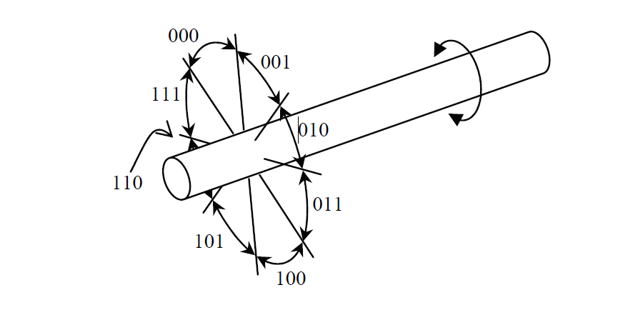
Eight Binary Values Identifying Rotating Shaft Position

Slide 47
One type of shaft position sensor uses a disk mounted to the shaft with slots cut into the disk at different radii representing different bits.
Light sources are placed on one side of the disk while sensors on the other side of the disk detect when a hole is present, i.e., the sensor is receiving light.
It is possible to read the sensor at the instant when more than one gap is opening or closing between its light source and sensor. When this happens, some of the bit changes may be detected while others are not. If this happens, an erroneous measurement may occur.
For example, if the shaft shown above turns clockwise toward position 101₂ = 5, but at the instant when the sensor is read, only the first bit change is detected, then the value read will be 111₂ = 7 indicating counter-clockwise rotation.
To solve this problem, alternate counting sequences referred to as the Gray code are used; These sequences have only one bit change between values.

Slide 48
For example, the values assigned to the arcs of the above shaft could follow the sequence 000, 001, 011, 010, 110, 111, 101, 100. This sequence is not correct numerically, but as the shaft turns, only one bit will change as the shaft turns from one position to the next.
There is an algorithm to convert an n-bit unsigned binary value to its corresponding n-bit Gray code.
Begin by adding a 0 to the most significant end of the unsigned binary value. There should now be n boundaries between the n+1 bits.
For each boundary, write a 0 if the adjacent bits are the same and a 1 if the adjacent bits are different.
The resulting value is the corresponding n-bit Gray code value.

Slide 49
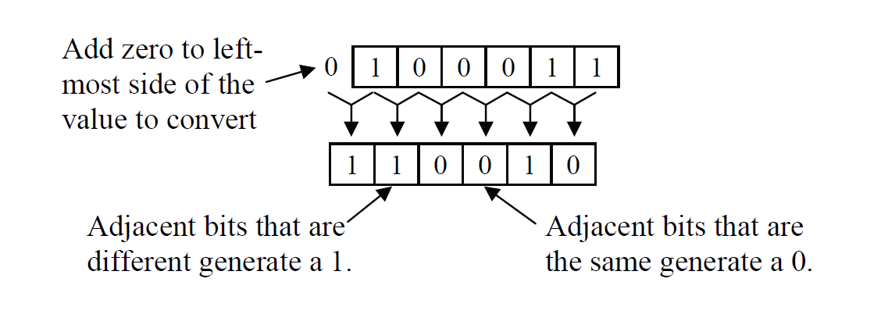
Example convert the 6 bit value 100011₂ to Gray code

Slide 50
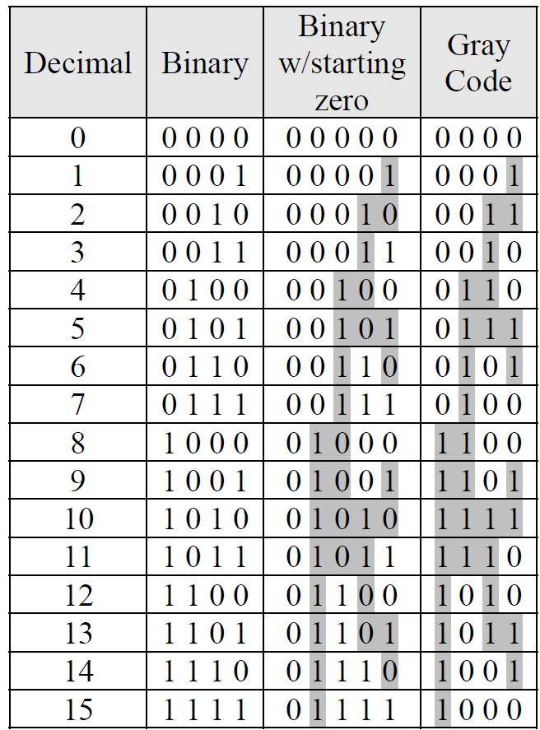
Derivation of the Four-Bit Gray Code

Slide 51
Assignment
1. Create the 5-bit Gray code sequence
2. Convert the following numbers to hexadecimal.
    a) 1010111100101100011₂
    b) 10010101001001101001₂
    c) 01101101001010011001₂
    d) 10101100100010₂

Slide 52
Thank you for listening

